Slide 1

Cloud Computing and Services
Homework 2
M10615032 宋狄勳
M10615095 謝義桐
M10615029 劉珈妤

Slide 2

Outline
Installation Result
Installing Process
References

Slide 3
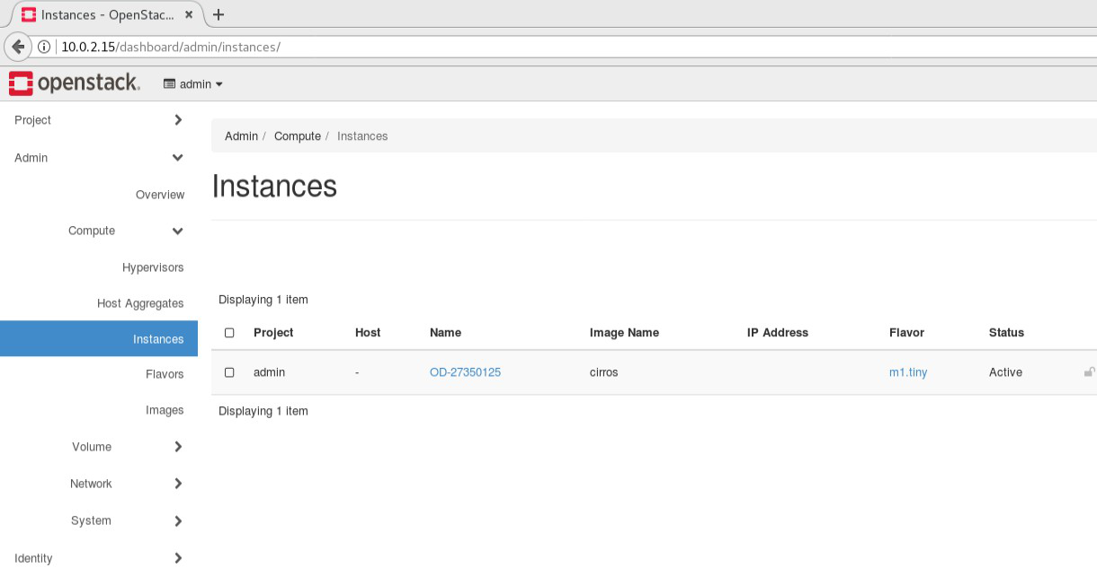
Installation Result
參賽編號：OD-27350125

Slide 4
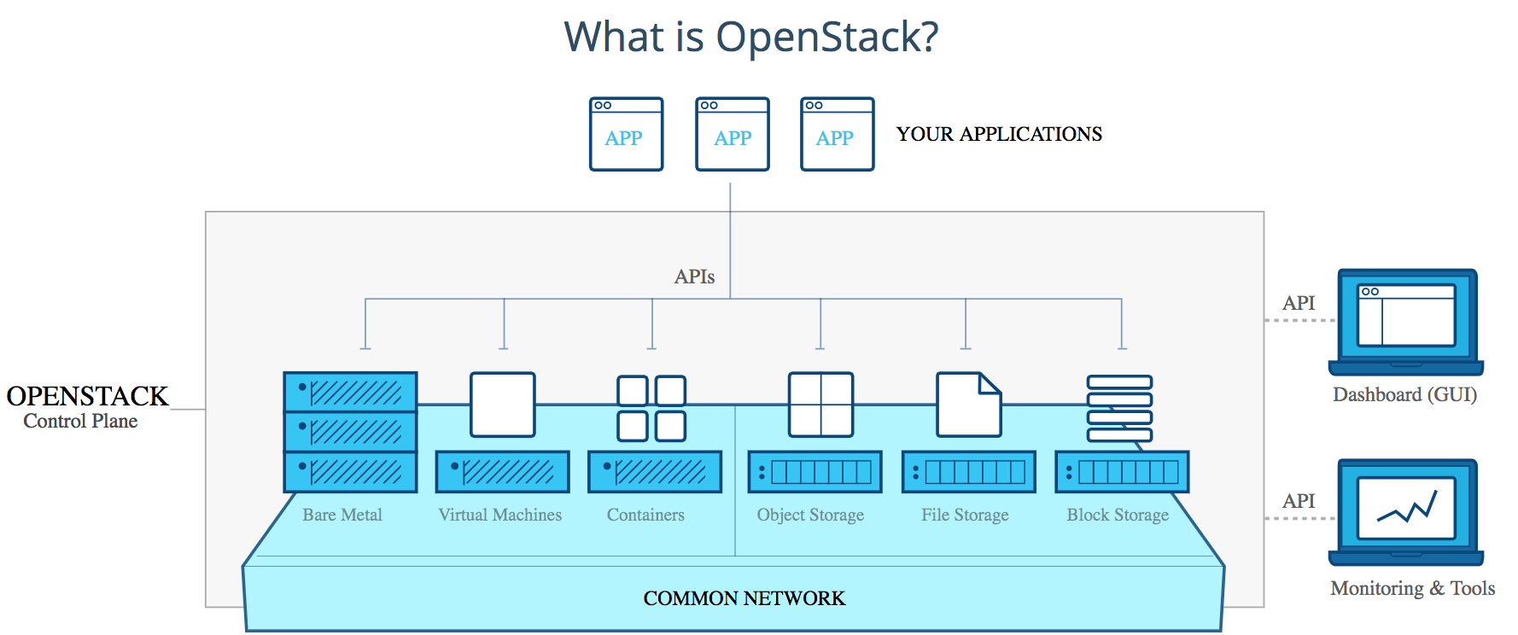
OpenStack is an open-source cloud operating system that control many devices, all managed through a dashboard, mostly used as infrastructure-as-a-service (IaaS), whereby virtual servers and other resources are made available to customers.

Slide 5
Installing Process
Installation - 在 CentOS 7 上透過 Yum 安裝 RDO 包、安裝 packstack all-in 套件。
Basic instructions - 透過基本指令來檢查像是帳戶、服務等 OpenStack 內部資料。
Network segment modification - packstack 預設 public 網段與現實環境不同，需重新指定一個適合的 public 網段。
Creating new instance - 建立新的實體。

Slide 6
Installation
OpenStack support Ubuntu, CentOS, Windows Server…...

Slide 7
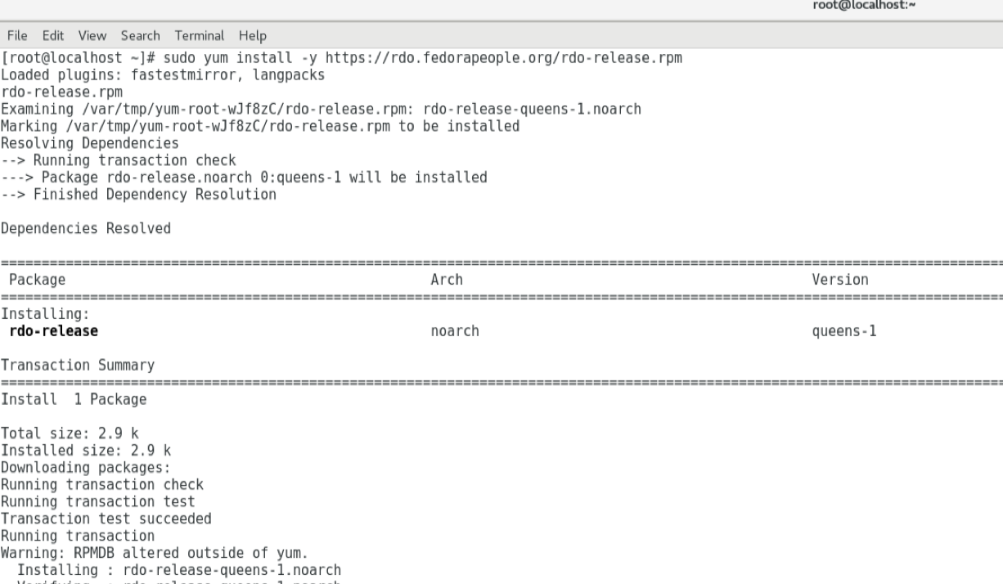
Download OpenStack （1/3)
透過 Yum 安裝 RDO 包
$ git clone https://git.openstack.org/openstack-dev/devstack
$ cd devstack

Slide 8
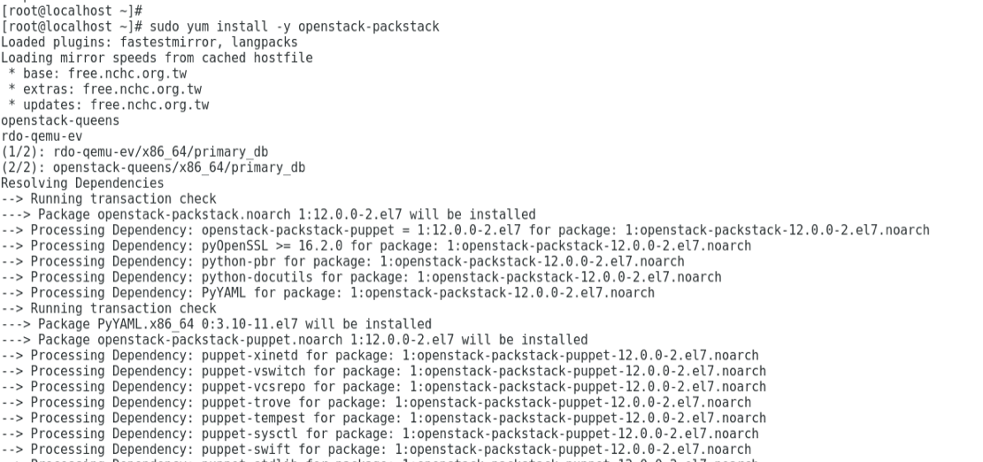
Download OpenStack (2/3)
安裝 packstack 套件
最新版本：queens

Slide 9
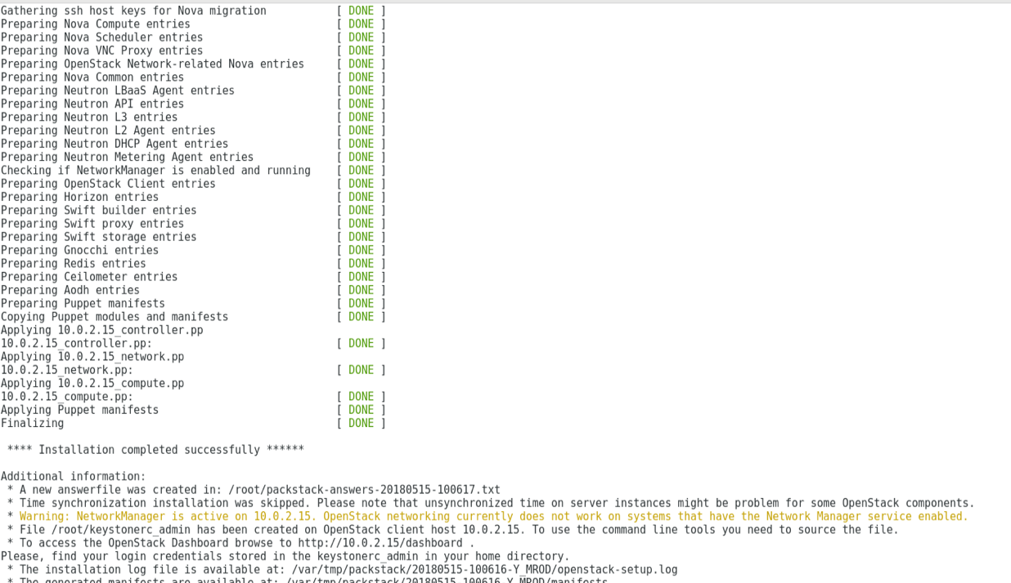
Download OpenStack (3/3)
安裝 Single Node 模式
packstack --allinone
Installation completed successfully!

Slide 10
安裝完成後關掉 Network Manager 服務
# sudo systemctl disable NetworkManager # sudo systemctl stop NetworkManager

Slide 11
修改 ens33 網卡使用 vSwitch
修改 ens33 網卡使用 vSwitch
# vi /etc/sysconfig/network-scripts/ifcfg-ens33
修改文件內容
DEVICE=ens33 TYPE=OVSPort DEVICETYPE=ovs OVS_BRIDGE=br-ex ONBOOT=yes

Slide 12
在 vSwitch 網卡配置網絡地址
在 vSwitch 網卡配置網絡地址 # vi /etc/sysconfig/network-scripts/ifcfg-br-ex
修改文件內容
DEVICE=br-ex DEVICETYPE=ovs TYPE=OVSBridge BOOTPROTO=static IPADDR=192.168.111.251 NETMASK=255.255.255.0 GATEWAY=192.168.111.1 DNS1=8.8.8.8 ONBOOT=yes

Slide 13
Restart network
# sudo systemctl restart network

Slide 14
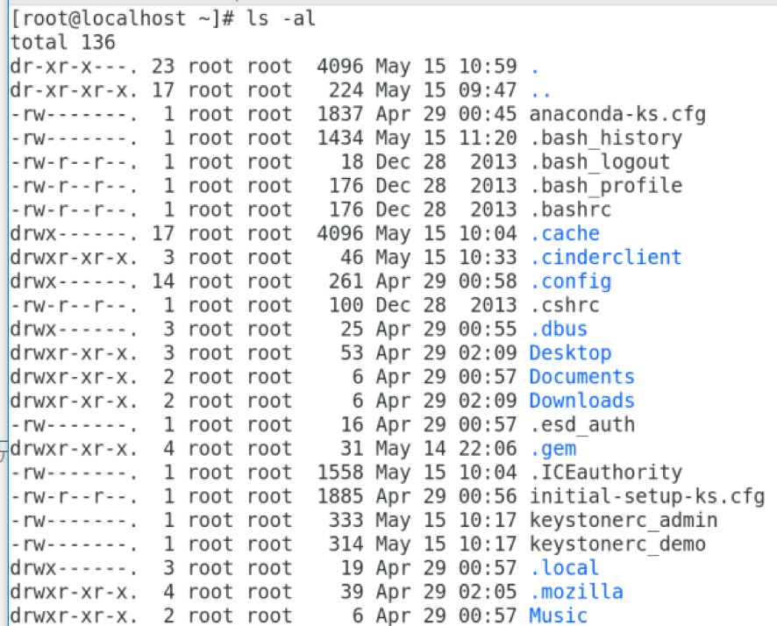
確認 OpenStack 檔案
OpenStack 環境變數

Slide 15
Basic Instructions
Checking account, URL, service list status, etc.

Slide 16
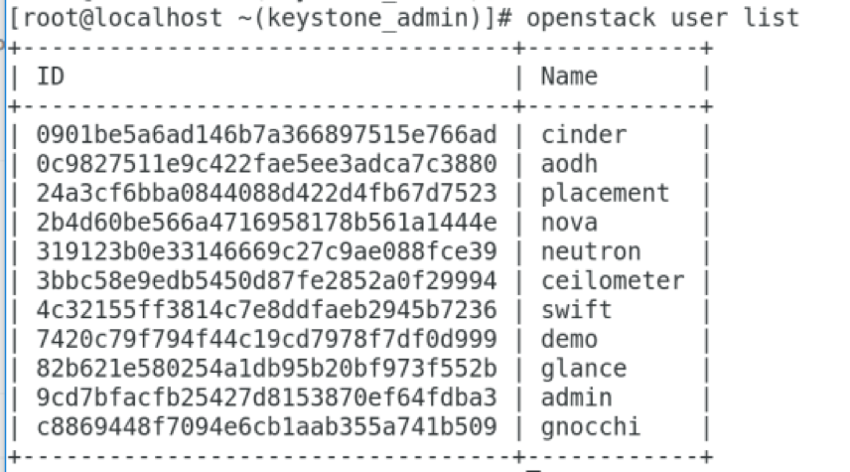
# openstack user-list 檢查現有帳戶狀況

Slide 17
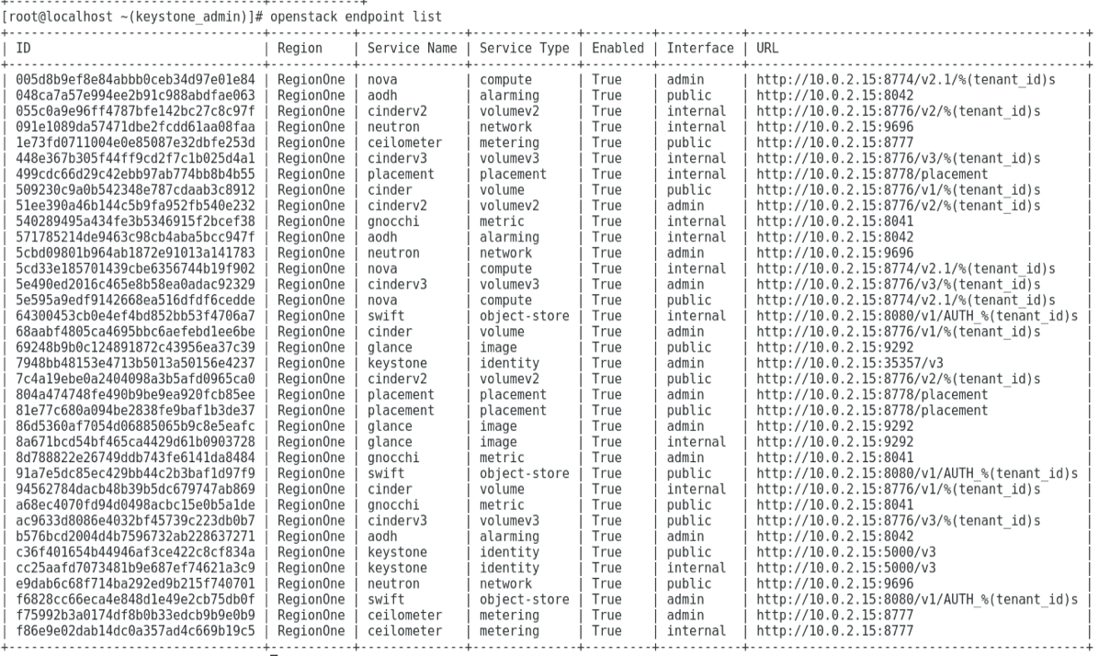
# openstack endpoint-list 顯示端點的 URL 狀態

Slide 18
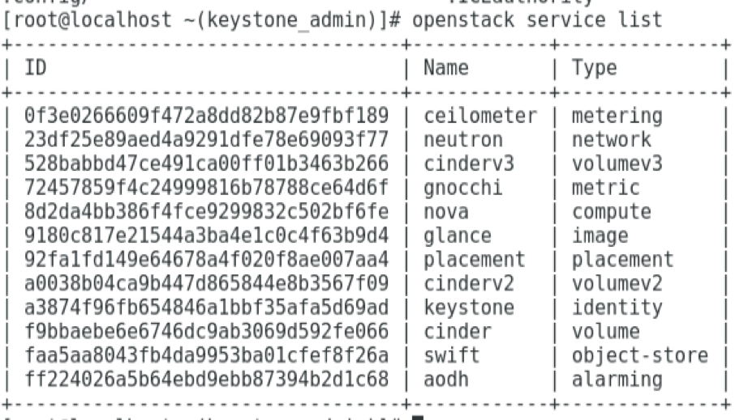
# openstack service-list 顯示各服務狀態

Slide 19
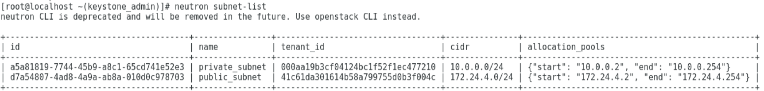
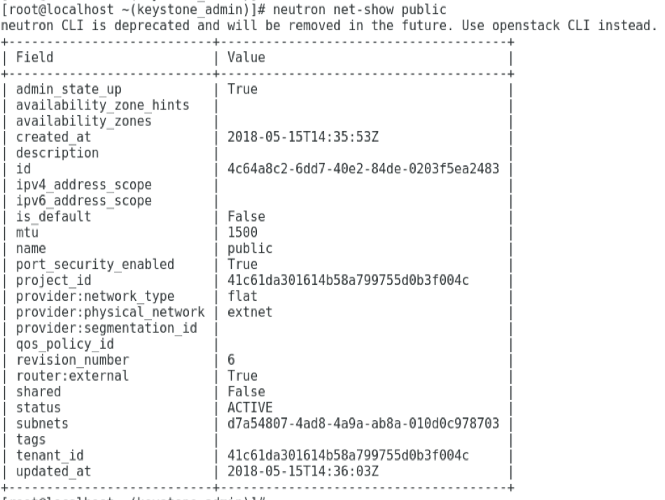
# openstack subnet-list 檢查現在有多少個網段
# openstack net-show public 檢查 public 網段內容

Slide 20
Network Segment Modification
Change the network segment for fit our environment.

Slide 21
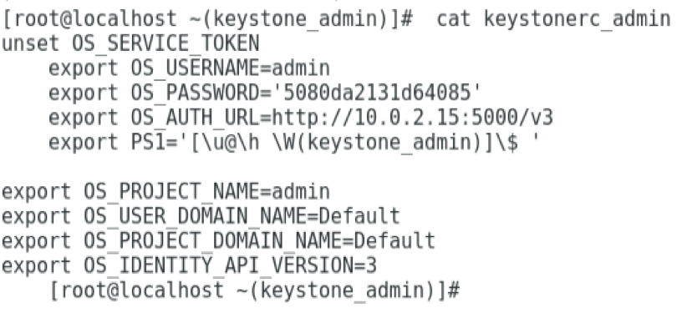
# cat keystonerc_admin 查看 admin 密碼
Admin password

Slide 22
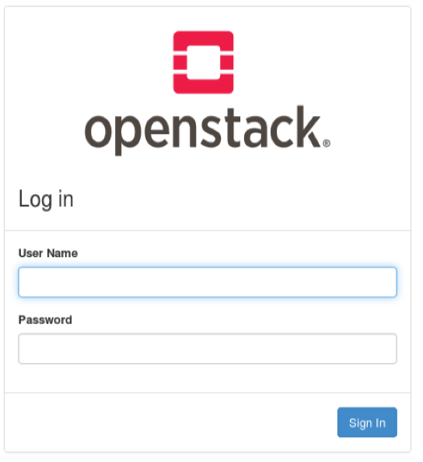
輸入http://server_ip/dashboard 登入 Horizon 網頁介面
User Name: Admin Password:
5080da2131d64085

Slide 23
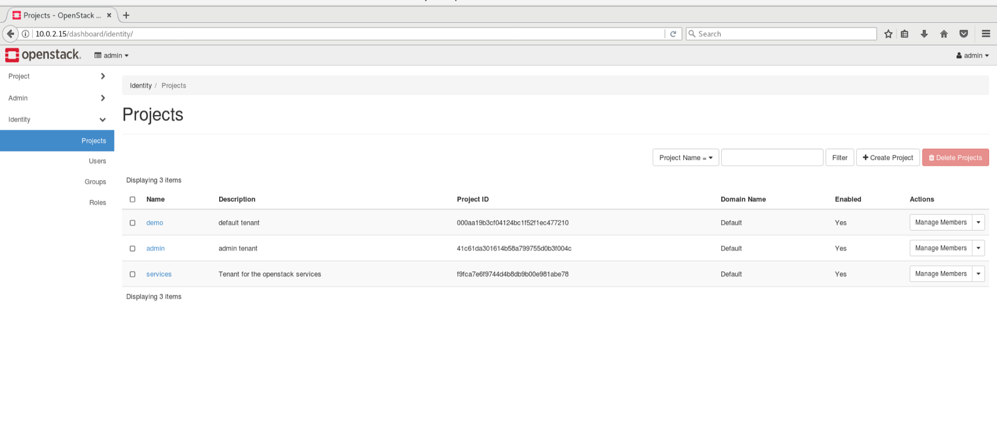

Slide 24
Creating new instance
Using Horizon web page to create our new instance.

Slide 25
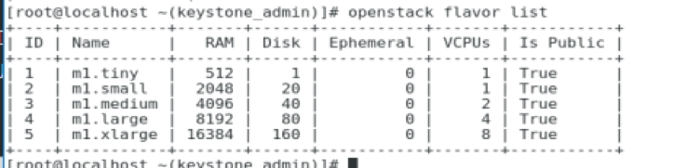
Creating new instance (1/4)
List the available flavors.
The flavor is an hardware configuration for a server which defines the compute, memory, and storage capacity of nova computing instances; for example the size of a virtual server that can be launched.

Slide 26
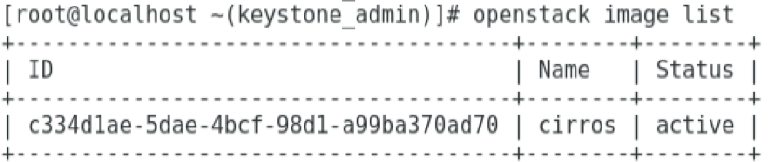
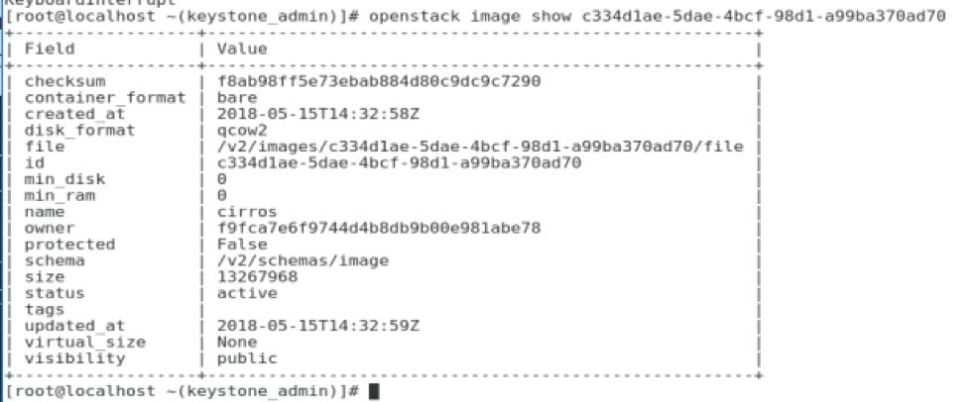
Creating new instance (2/4)
List the available images.

Slide 27
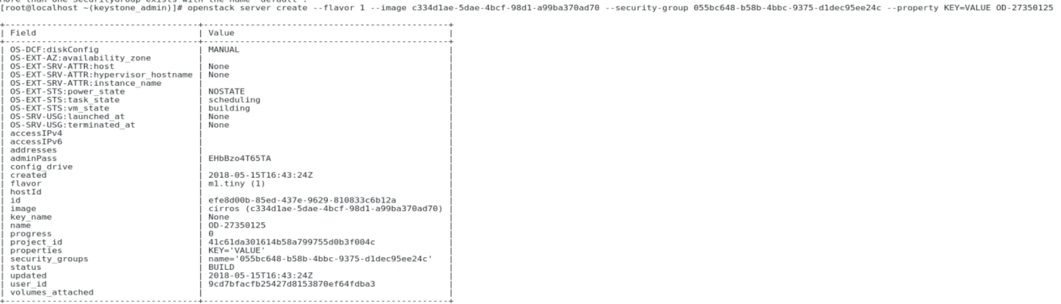
Creating new instance (3/4)
# openstack server create --flavor 1 --image c334d1ae-5dae-4bcf-98d1-a99ba370ad70 --security-group 055bc648-b58b-4bbc-9375-d1dec95ee24c --property KEY=VALUE OD-27350125

Slide 28
Creating new instance (4/4)
KEY=VALUE OD-27350125

Slide 29
References
(第四篇) OpenStack 配置複雜到「跌渣」！RDO 懶人包解決一切煩惱 – 安裝及基本指令:https://hkitblog.com/%E7%AC%AC%E5%9B%9B%E7%AF%87-openstack-%E9%85%8D%E7%BD%AE%E8%A4%87%E9%9B%9C%E5%88%B0%E3%80%8C%E8%B7%8C%E6%B8%A3%E3%80%8D%EF%BC%81rdo-%E6%87%B6%E4%BA%BA%E5%8C%85%E8%A7%A3%E6%B1%BA%E4%B8%80%E5%88%87/
Launch an instance from an image: https://docs.openstack.org/nova/queens/user/launch-instance-from-image.html

Slide 30

Thanks!
Any questions?

